Slide 1
Lecture 9 & 10: Solving Linear Recurrence Relations
Section 8.2

Slide 2
Section Summary
Linear Homogeneous Recurrence Relations
Solving Linear Homogeneous Recurrence Relations with Constant Coefficients.
Solving Linear Nonhomogeneous Recurrence Relations with Constant Coefficients. (Self Study)

Slide 3
Linear Homogeneous Recurrence Relations
Definition: A linear homogeneous recurrence relation of degree k with constant coefficients is a recurrence relation of the form a_{n} = c₁a_{n−1} + c₂a_{n−2} + ….. + c_{k} a_{n−k} , where c₁, c₂, ….,c_{k} are real numbers, and c_{k} ≠ 0.
It is linear because the right-hand side is a sum of the previous terms of the sequence each multiplied by a function of n.
It is homogeneous because no terms occur that are not multiples of the recursive elements.
Each coefficient is a constant.
The degree is k because a_{n} is expressed in terms of the previous k terms of the sequence.

Slide 4
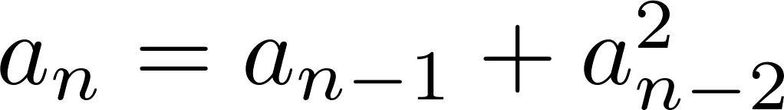
Examples of Linear Homogeneous Recurrence Relations
P_{n} = (1.11)P_{n–1} | linear homogeneous recurrence relation of degree one
f_{n} = f_{n–1} + f_{n–2} | linear homogeneous recurrence relation of degree two
 | not linear
H_{n} = 2H_{n−1} + 1 | not homogeneous
B_{n} = nB_{n−1} | coefficients are not constants
a_{n} = a_{n−5} | linear homogeneous recurrence relation of degree five

Slide 5
Solving Linear Homogeneous Recurrence Relations
The basic approach is to look for solutions of the form
a_{n} = r ^{n}, where r is a constant (Geometric progression).
Notice that a_{n} = r^{n} is a solution to the recurrence relation
a_{n} = c₁a_{n−1} + c₂a_{n−2} + ⋯ + c_{k} a_{n−k}
if and only if r ^{n} = c₁r ^{n−1} + c₂r ^{n−2} + ⋯ + c_{k} r ^{n−k} .
Divide both sides of this equation by r^{n−k}.
r^{k} = c₁r^{k−1} + c₂r^{k−2} + ⋯ + c_{k−1}r + c_{k}

Slide 6
Solving Linear Homogeneous Recurrence Relations
Algebraic manipulation yields the characteristic equation:
r^{k} − c₁r^{k−1} − c₂r^{k−2} − ⋯ − c_{k−1}r − c_{k} = 0
The sequence {a_{n}} with a_{n} = r^{n} is a solution if and only if
r is a solution to this equation.
The solutions to the characteristic equation are called the characteristic roots of the recurrence relation. The roots are used to give an explicit formula for all the solutions of the recurrence relation.

Slide 7
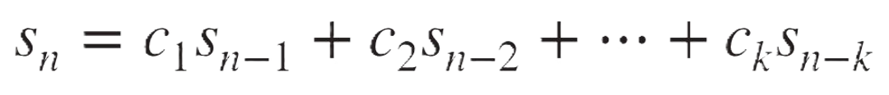
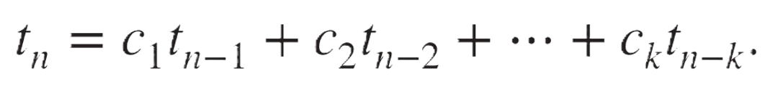
Solving Linear Homogeneous Recurrence Relations
Another observation:
A linear combination of two solutions is also a solution.
So, if the recurrence a_{n} = c₁a_{n−1} + c₂a_{n−2} + ⋯ + c_{k} a_{n−k}
have s_{n} and t_{n} both as valid solutions, so,
and
Consider a linear combination of s_{n} and t_{n} : b₁s_{n} + b₂t_{n} ,
where b₁ and b₂ are real numbers.

Slide 8

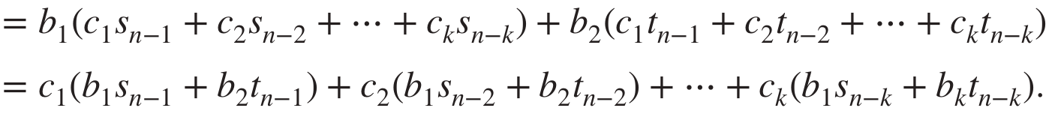
Solving Linear Homogeneous Recurrence Relations
We have:
So, if s_{n} and t_{n} both are solutions, then b₁s_{n} + b₂t_{n} is also a solution.
Combining that with the idea solutions can be of the form r^{n}, gives us the following theorem:

Slide 9
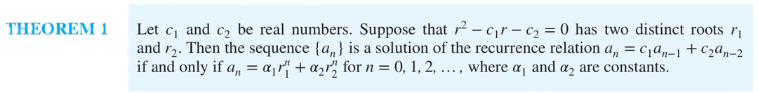
Solving Linear Homogeneous Recurrence Relations of Degree Two
Let c₁ and c₂ be real numbers.
Suppose that r ² − c₁r − c₂ = 0 has two distinct roots r₁ and r₂.
Now, the degree-2 recurrence relation, a_{n} = c₁a_{n−1} + c₂a_{n−2} has the solution of the form: a_{n} = 𝛼₁r₁^{n} + 𝛼₂r₂^{n} for n = 0, 1, 2, …, where 𝛼₁ and 𝛼₂ are constants.

Slide 10
Solving Linear Homogeneous
Recurrence Relations of Degree Two
Example: What is the solution to the recurrence relation
a_{n} = a_{n−1} + 2a_{n−2} with a₀ = 2 and a₁ = 7?
Solution:
Step-1: find the characteristic equation
For our degree 2 recurrence relations, the characteristic equation is r² − r − 2 = 0. (c₁ = 1, c₂ = 2)
Step-2: find the roots of the characteristic equation
Its roots are r = 2 and r = −1.
Step-3: find the general solution format with α₁ and α₂
Therefore, {a_{n}} is a solution if and only if a_{n} = α₁2^{n} + α₂(−1)^{n},
for some constants α₁ and α₂.
Step-4: find the values of α₁ and α₂ using the initial conditions
a₀ = 2 = α₁ + α₂ and a₁ = 7 = α₁2 + α₂(−1).
Solving these equations, we find that α₁ = 3 and α₂ = −1.
Hence, the solution is the sequence {a_{n}} with a_{n} = 3∙2^{n} − (−1)^{n}.

Slide 11
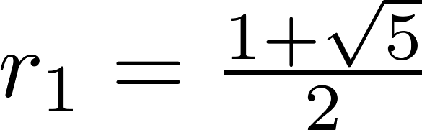
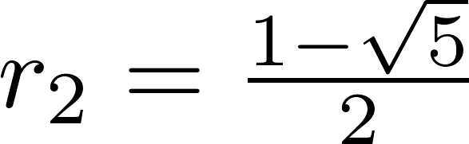
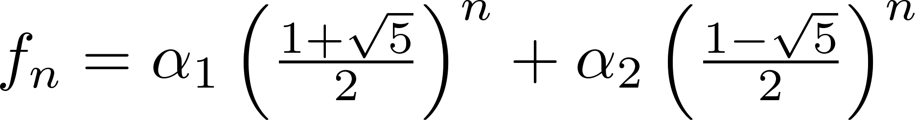
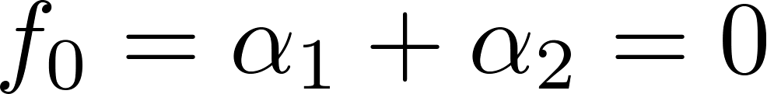
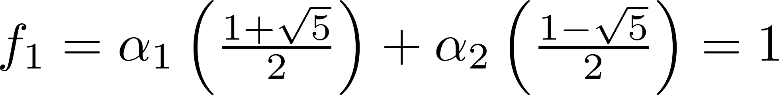
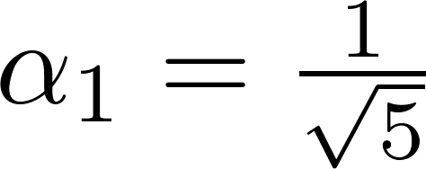
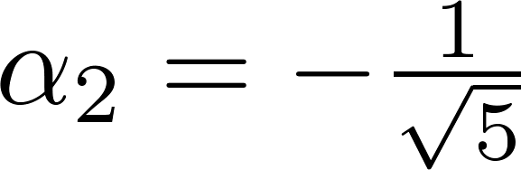
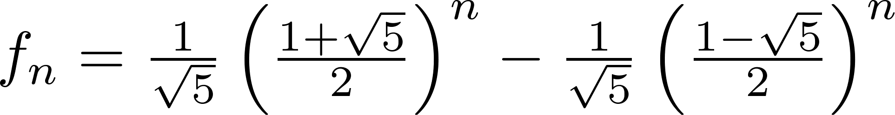
An Explicit Formula for the Fibonacci Numbers
We can find an explicit formula for the Fibonacci numbers. The sequence of Fibonacci numbers satisfies the recurrence relation: f_{n} = f_{n−1} + f_{n−2} with the initial conditions: f₀ = 0 and f₁ = 1.
Solution: The roots of the characteristic equation r ² – r – 1 = 0 are:
, .
So, for some constants α₁ and α₂,
Using the initial conditions:
;
We solve these equations to find: ,
Thus,

Slide 12
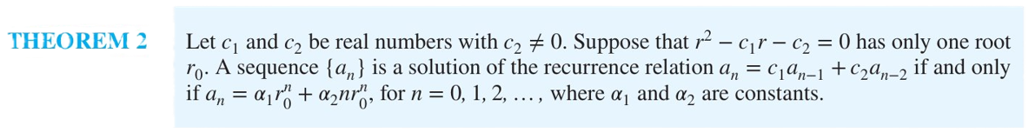
What if there is a repeated root from the characteristic equation?
Let c₁ and c₂ be real numbers with c₂ ≠ 0.
Suppose that r ² – c₁r – c₂ = 0 has one repeated root r₀.
Then the sequence {a_{n}} is a solution to the recurrence relation a_{n} = c₁a_{n−1} + c₂a_{n−2} if and only if
a_{n} = 𝛼₁r₀^{n} + 𝛼₂nr₀^{n}
for n = 0, 1, 2, … , where α₁ and α₂ are constants.

Slide 13
Example Problem
Example: What is the solution to the recurrence relation
a_{n} = 6a_{n−1} − 9a_{n−2} with a₀ = 1 and a₁ = 6?
Solution: The characteristic equation is r ² − 6r + 9 = 0.
The only root is r = 3.
Therefore, {a_{n}} is a solution if and only if a_{n} = α₁3^{n} + α₂n(3)^{n} ,
where α₁ and α₂ are constants.
From the given initial conditions,
a₀ = 1 = α₁ and, a₁ = 6 = α₁ ∙ 3 + α₂ ∙ 1 ∙ 3.
Solving, we find that α₁ = 1 and α₂ = 1 .
Hence, a_{n} = 3^{n} + n3^{n} .

Slide 14
Solving Linear Homogeneous Recurrence Relations of Arbitrary Degree
This theorem can be used to solve linear homogeneous recurrence relations with constant coefficients of any degree when the characteristic equation has distinct roots.
Theorem 3: Let c₁, c₂ ,…, c_{k} be real numbers. Suppose that the characteristic equation
r^{k} – c₁r^{k−1} –⋯ – c_{k} = 0
has k distinct roots r₁, r₂, …, r_{k}. Then a sequence {a_{n}} is a solution of the recurrence relation a_{n} = c₁a_{n−1} + c₂a_{n−2} + ….. + c_{k} a_{n−k}
if and only if
a_{n} = α₁r₁^{n} + α₂r₂^{n} + … + α_{k}r_{k}^{n}.
for n = 0, 1, 2, …, where α₁, α₂,…, α_{k} are constants.

Slide 15
Example Problem
Example: What is the solution to the recurrence relation
a_{n} = 6a_{n−1} − 11a_{n−2} + 6a_{n−3} with a₀ = 2, a₁ = 5, a₂ = 15?
Solution: The characteristic equation is r ³ – 6r ² + 11r – 6 = 0.
The roots are, r₁ = 1, r₂ = 2, r₃ = 3.
Therefore, the solution is of the form a_{n} = α₁1^{n} + α₂2^{n} + α₃3^{n} ,
where α₁, α₂ and α₃ are constants.
From the given initial conditions,
a₀ = 2 = α₁ + α₂ + α₃ , a₁ = 5 = α₁ + α₂ ∙ 2 + α₃ ∙ 3 and
a₂ = 15 = α₁ + α₂ ∙ 4 + α₃ ∙ 9
Solving, we find that α₁ = 1 and α₂ = –1 and α₃ = 2.
Hence, a_{n} = 1 – 2^{n} + 2∙ 3^{n}.

Slide 16
The General Case with Repeated Roots Allowed
Theorem 4: Let c₁, c₂ ,…, c_{k} be real numbers. Suppose that the characteristic equation
r^{k} – c₁r^{k−1} –⋯ – c_{k} = 0
has t distinct roots r₁, r₂, …, r_{t} with multiplicities m₁, m₂, …, m_{t}, respectively so that m_{i} ≥ 1 for i = 0, 1, 2, … , t and m₁ + m₂ + … + m_{t} = k.
Then a sequence {a_{n}} is a solution of the recurrence relation
a_{n} = c₁a_{n−1} + c₂a_{n−2} + ….. + c_{k} a_{n−k}
if and only if
for n = 0, 1, 2, …, where α_{i,j} are constants for 1≤ i ≤ t and 0≤ j ≤ m_{i−1}.

Slide 17
Example Problem
Example: Suppose that the roots of the characteristic equation of a linear homogeneous recurrence relation are 2, 2, 2, 5, 5 and 9. What is the form of the general solution?
Solution: Here, there are only 3 roots,
r₁ = 2, with multiplicity 3, r₂ = 5, with multiplicity 2 and
r₃ = 9, with multiplicity 1.
Therefore, the solution is of the form:
a_{n} = (α_{1,0} + α_{1,1}n + α_{1,2}n²)(2)^{n}
+ (α_{2,0} + α_{2,1}n)(5)^{n}
+ (α_{3,0})(9)^{n}

Slide 18
Example Problem
Example: What is the solution to the recurrence relation
a_{n} = − 3a_{n−1} − 3a_{n−2} − a_{n−3} with a₀ = 1, a₁ = −2, a₂ = −1?
Solution: The characteristic equation is r ³ + 3r ² + 3r + 1 = 0.
There is only a single root, r = −1, with multiplicity 3.
Therefore, the solution is of the form
a_{n} = α_{1,0}(−1)^{n} + α_{1,1}n(−1)^{n} + α_{1,2}n²(−1)^{n}
a_{n} = (α_{1,0} + α_{1,1}n + α_{1,2}n²)(−1)^{n}
where α_{1,0}, α_{1,1} and α_{1,2} are constants.
From the given initial conditions,
a₀ = 1 = α_{1,0} , a₁ = –2 = – α_{1,0} – α_{1,1} – α_{1,2} and
a₂ = –1 = α_{1,0} + 2α_{1,1} + 4α_{1,2}.
Solving, we find that α_{1,0} = 1 and α_{1,1} = 3 and α_{1,2} = –2.
Hence, a_{n} = (1 + 3n – 2n²) (–1)^{n}.

